Slide 1



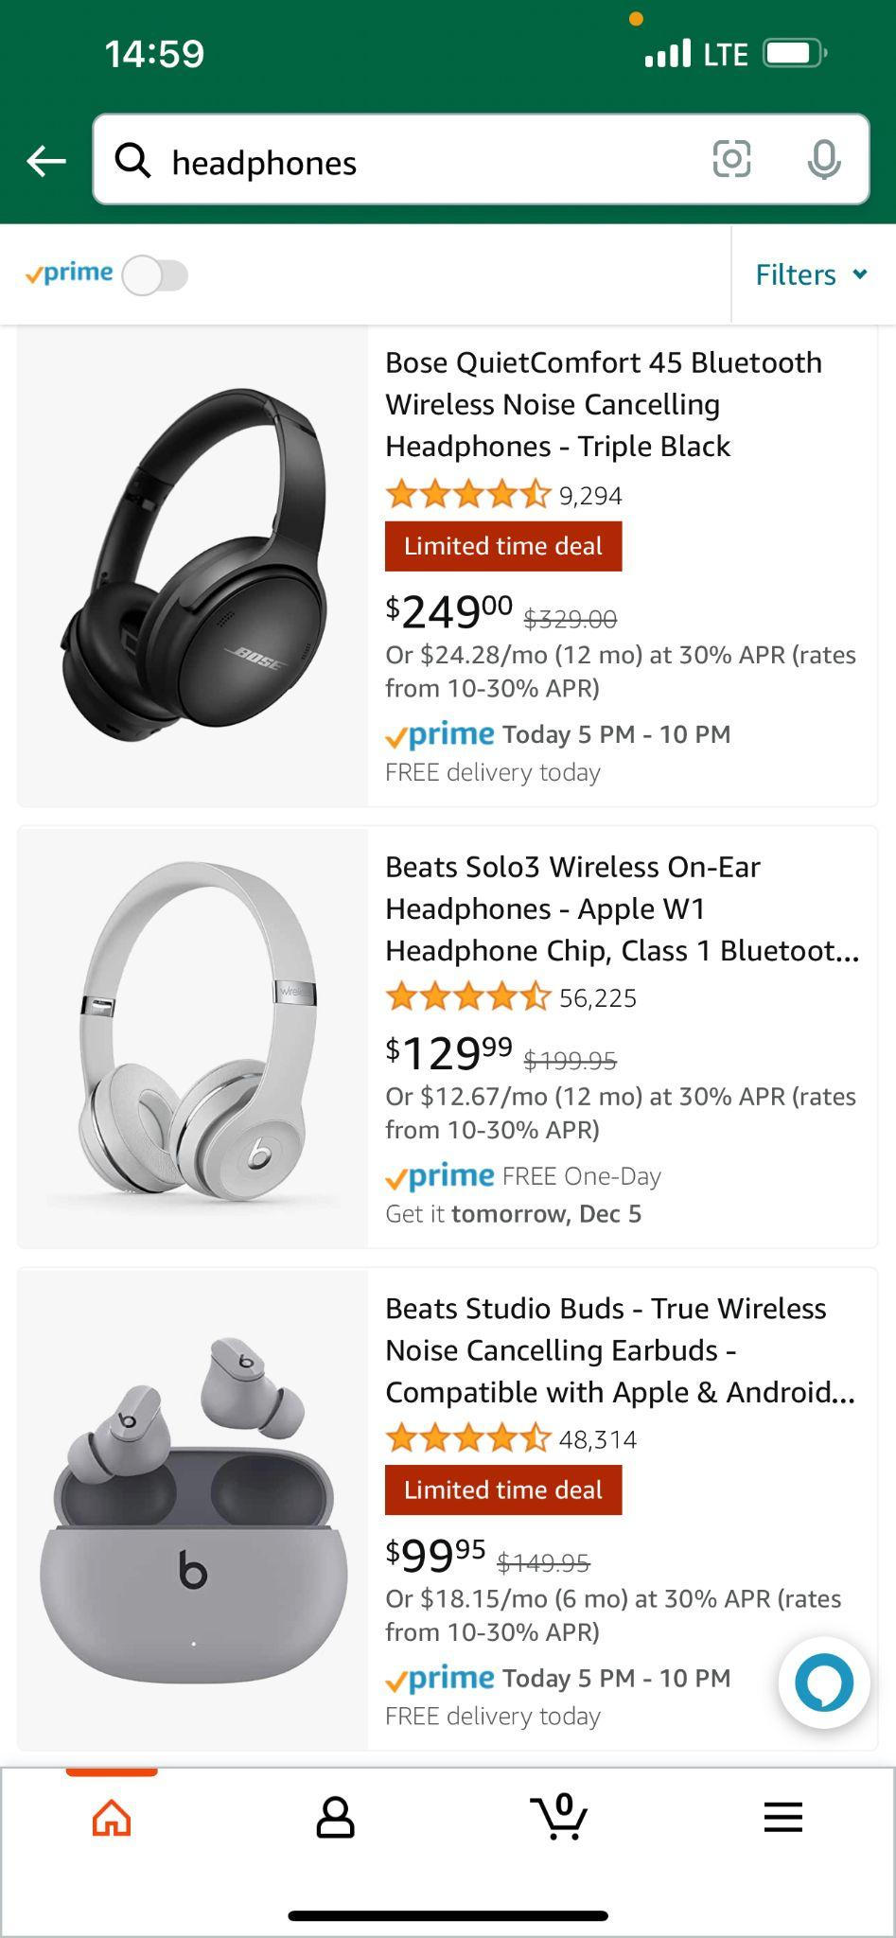
Product Review Sentiment Analyzer based on
Brand ?
Price ?
Yanfeng(Jennifer) Zhang yz1045
Zijing(Mavis) Cheng zc233
Xin(Iris) Xiang xx123
Product Information ?

Slide 2
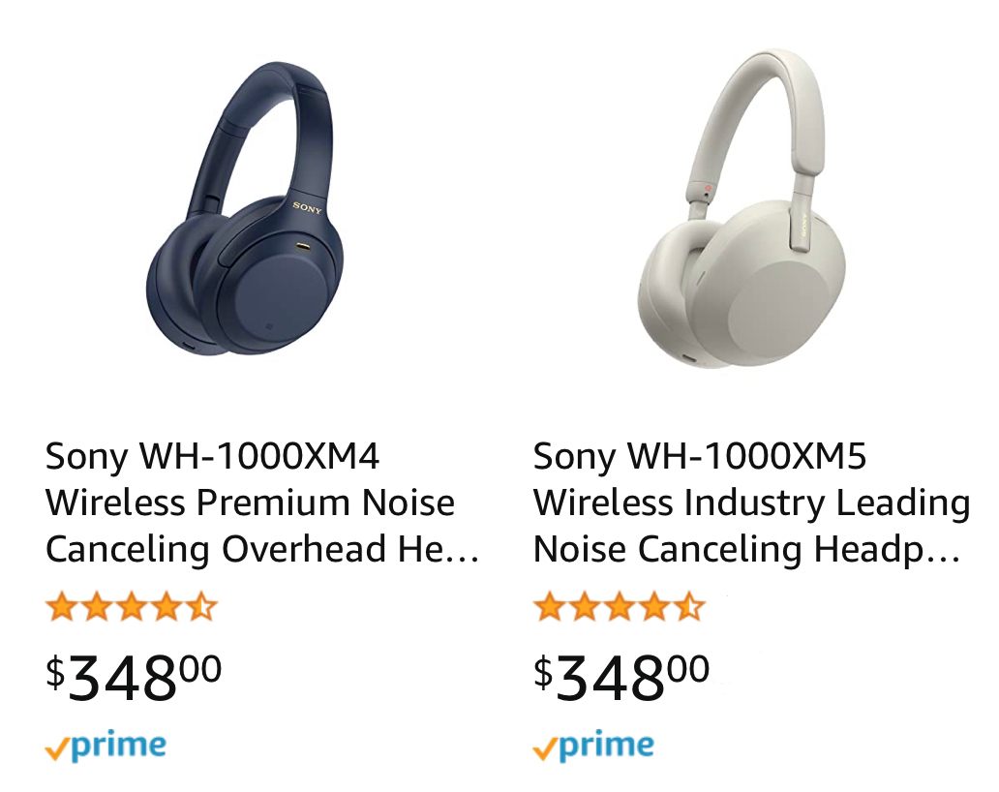

Product Review Sentiment Analyzer based on
Yanfeng(Jennifer) Zhang yz1045
Zijing(Mavis) Cheng zc233
Xin(Iris) Xiang xx123
Brand ?
Price ?
Product Information ?
Notes:
Imagine you're swiping you screen to pick out a new pair of headphones on Amazon. What should go into your selection process?
The Brand? The Price? OR The detail information about the product?

Slide 3
Notes:
I believe, when it’s time to choose between similar-looking products, many of you may directly look at the ratings,

Slide 4

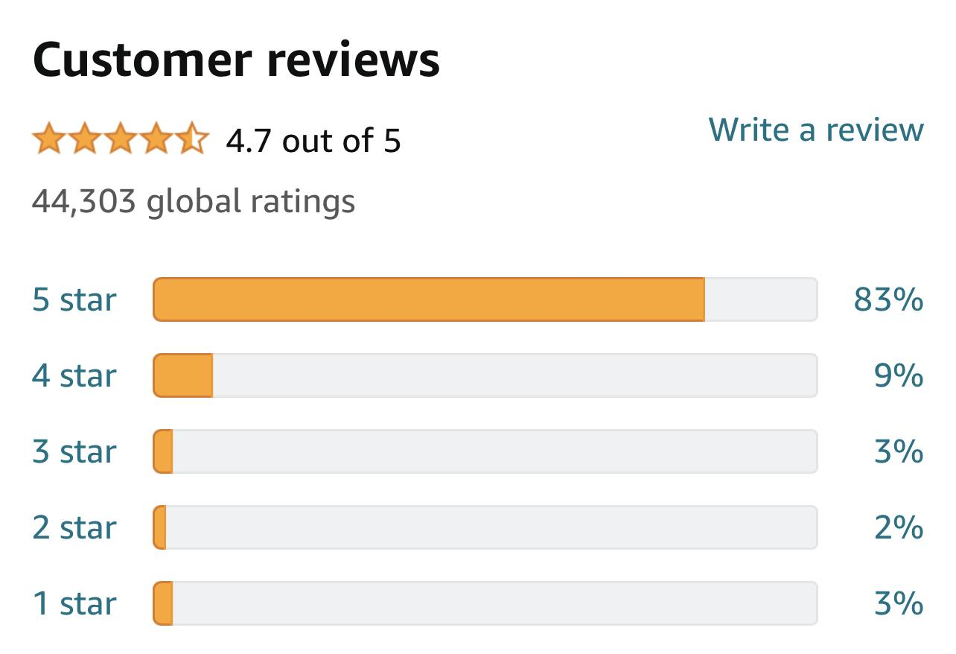
🌟Rating 🌟
Notes:
which it's intuitive and obvious，it's direct information that you can get without any thinking
However, have you considered a situation where some of the reviews you see are fake? Although most of the reviews are labeled as “Verified Purchase”,
Some of the desperate sellers pay for glowing reviews, and some offer gift cards in exchange for five-star ratings.
It’s tough to identify what’s real with certainty, especially you just want to take a glance to get an overall evaluation.
As a result of that, we are very likely to be misled just by rating.

Slide 5

🌟Rating🌟
🌟🌟🌟🌟🌟 – – Positive
🌟🌟🌟🌟
🌟🌟🌟 – –❓
🌟🌟
🌟 – – Negative
Notes:
Also, at the same time, everyone has different rating standards, unlike the obvious likes and dislikes of 1 star and 5 stars, it is even difficult for us to judge whether 3 points are positive or negative. And only through a number, we can't know the specific reason why it is scored as 3.

Slide 6

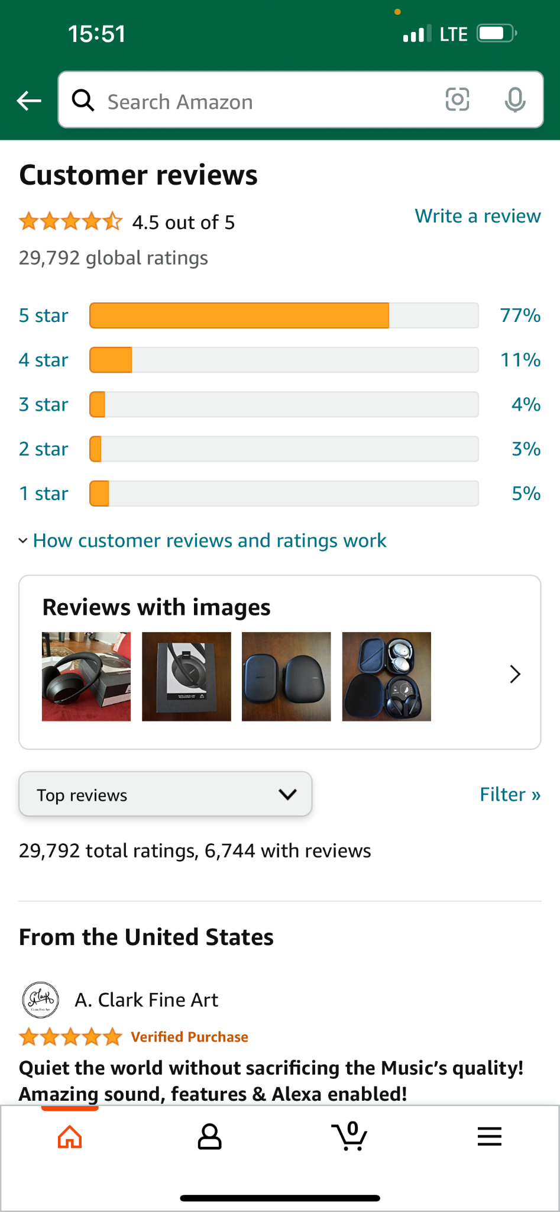
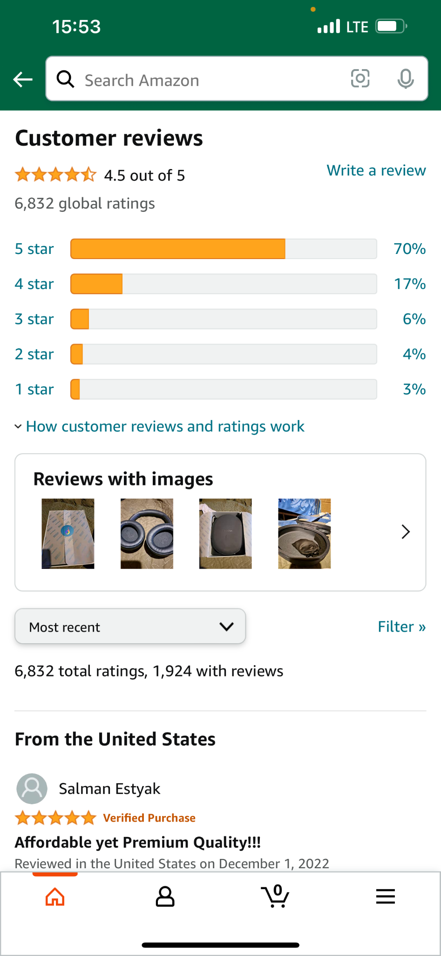
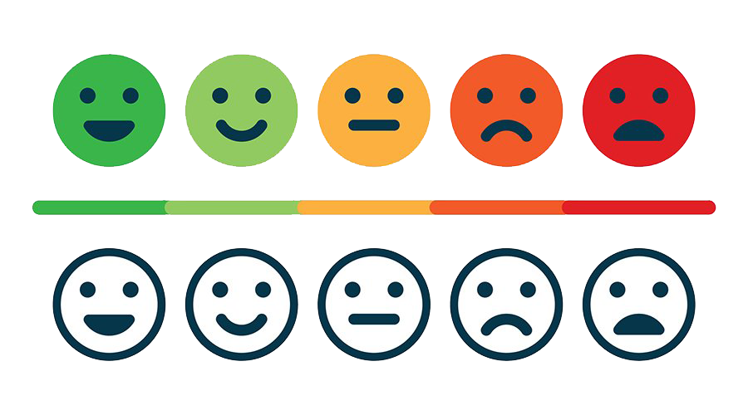
🌟Rating🌟
Notes:
Besides that, if the two products we want to compare have the same rating, such as they are both in 4.5, we cannot give a specific conclusion about the two products just by looking at the rating, for example, what is their excellent feature or where is their shortcoming

Slide 7
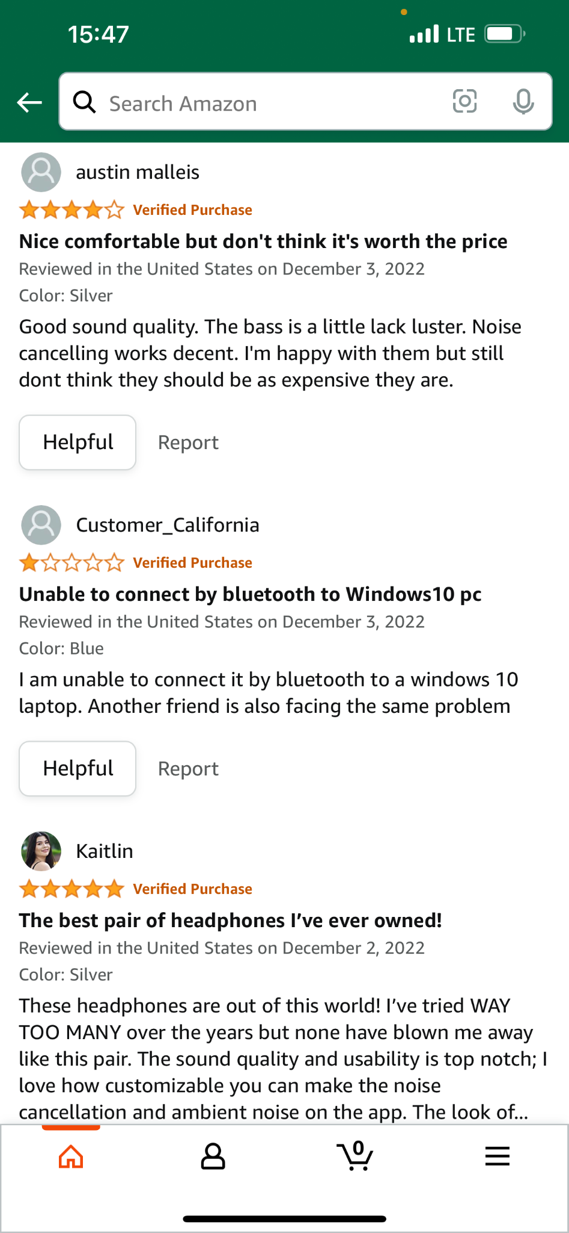
📝Review📝
Notes:
Compared with ratings, through user review, besides of the detailed information which we cannot get from the webpage, such as user experience, the emotion conveyed by users through text is also very important information, which can be an important factor in whether we buy this product

Slide 8

Customer Rating
Customer Review
Notes:
In this case, we need to combine costumer review to get more information.
Although there are also fake user comments like ratings, we can filter them through some features to minimize their influence

Slide 9

Customer Rating
Customer Review
Notes:
However, people prefer to compare product ratings first, because rating can directly give people the information they want without too much thinking. On the contrary, in the process of browsing product reviews, people need to locate the keywords they want to find in a large paragraph of text, such as sound quality, whether it is comfortable to wear,, etc. (Although it is not too complicated, it is still a relatively time-consuming process)

Slide 10


Our Project
Timesaving
Intuitive
Remove Bias:
Fake Reviews
Relatively Fair
Notes:
Therefore, our project, a Product Review Sentiment Analyzer, combines product ratings to re-rate products by analyzing the emotional expressions in the review text.
At the same time, we also reduce the influence of fake reviews to a greater extent, and give a more real and fair product rating.
In addition, we will also give a summary of the key words of the negative review obtained from the analysis, because when comparing similar products, users will pay more attention to the poor performance of the product than the advantages of the product.
In general, our goal is to give people a more intuitive and relatively fair rating and overall review without spending too much time browsing and identifying a large number of reviews.

Slide 11
01
02
03
Data Collection
Data Preprocessing
Methodology
04
05
06
Outcomes
Conclusion
Model Evaluation & Model Selection
Notes:
Next let's dive into each step of our project

Slide 12
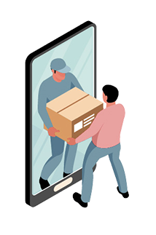
01
Data Collection

Slide 13

Data Introduction
Resource
Category
150 Products
103008 Reviews

Slide 14
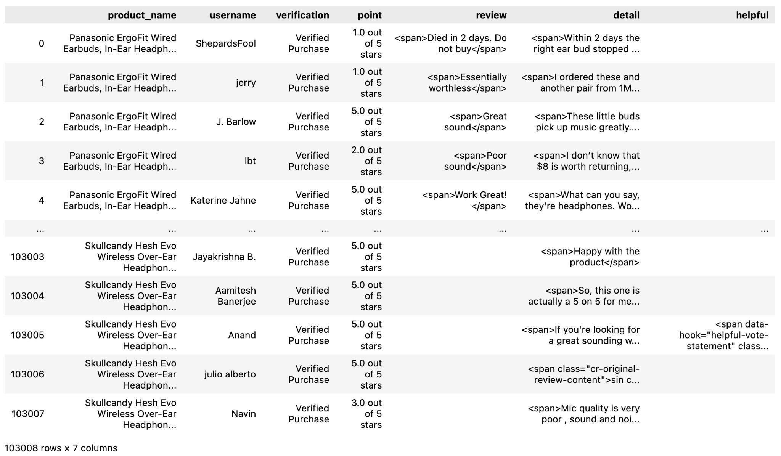
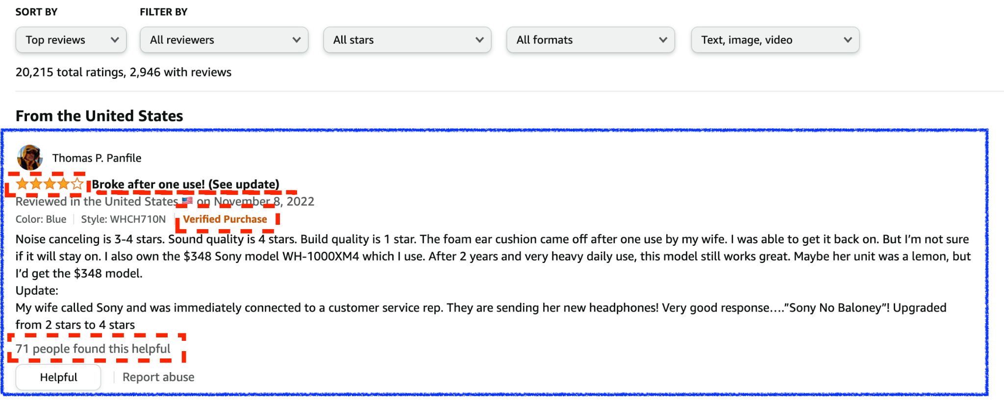
Data Collection

Slide 15
Data Collection
Data Collection
<Requests>

Slide 16

02
Data Preprocessing

Slide 17
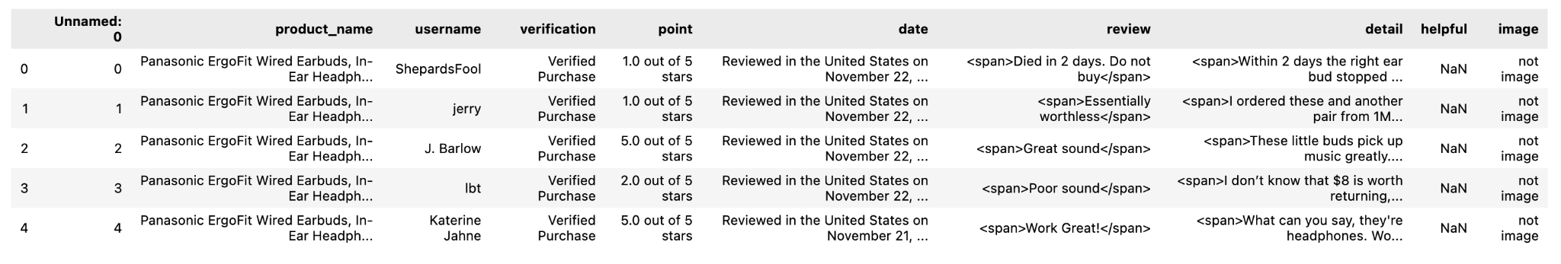

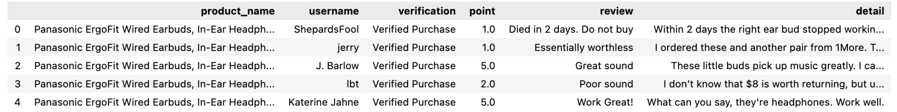
Data Preprocessing
Data Collection
Data Cleaning
Non-relative Variables
Missing Values
Punctuation
Emojis
Notes:
What I want to mentioned here is the helpful column

Slide 18
Data Collection
Data Preprocessing
Data Cleaning
Non-relative Variables
Missing Values
Punctuation
Emojis
Notes:
Users can click the helpful button even if they didn't purchase the item. so we thought that might have had an impact on the results

Slide 19
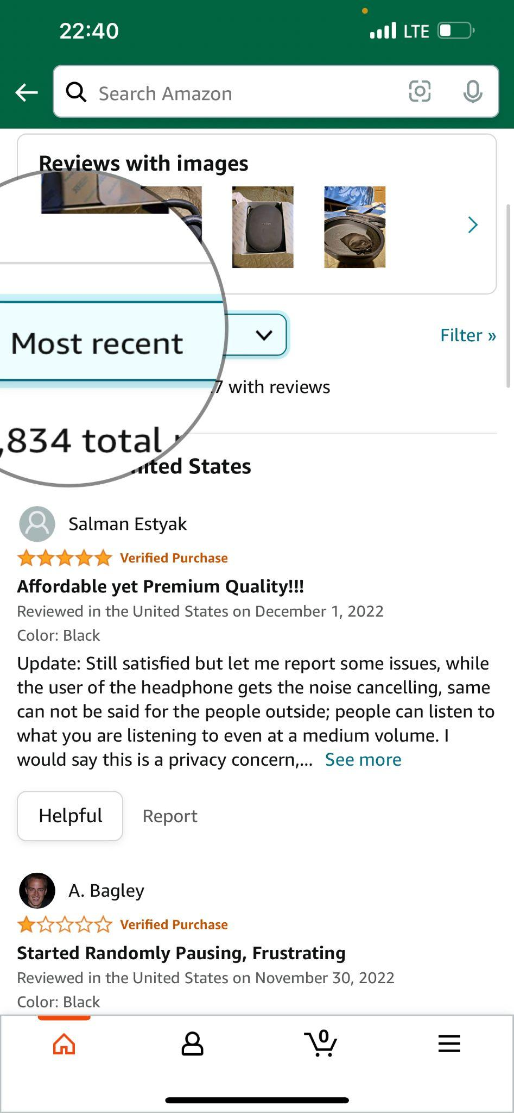
Data Preprocessing
Remove Fake Review
“Most Recent”
Review Length
Duplication
Similarity
Notes:
What I want to mentioned here is the helpful column

Slide 20

Data Preprocessing
Remove Fake Review
Length less than 5
Reviews from same user within 7 days
Review repetition rate large than 98%
“Most Recent”
Review Length
Duplication
Similarity
Notes:
We think that the probability of people buying the same product, especially headphones, within 7 days is very small

Slide 21
Data Preprocessing
Tokenization
Vectorization
TfidfTransformer()
Notes:
If you need the term frequency (term count) vectors for different tasks, use Tfidftransformer
because it not only focuses on the frequency of words present in the corpus but also provides the importance of the words. We can then
remove the words that are less important for analysis, hence making the model building less complex by reducing the input dimensions

Slide 22
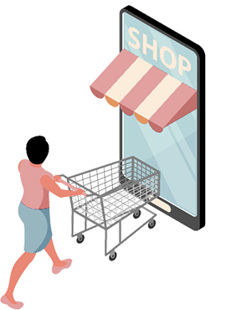
03
Methodology
Notes:
Then let’s come to the methodology part

Slide 23
General ideas
Vectorization
We build a feature vector that can be used for testing the models
Train classification models
Split our data into training and testing sets. We use training set and split it into training and validation set to train classification models and compare the models based on accuracy, f1-score, recall and precision of validation set
Parameter Tuning
The best performance in these models is SVC with polynomial kernel
Prediction on testing set
Finally, we predict the testing set with the best model
Machine Learning Methods and Deep Learning Methods
We divide training into two parts, machine learning methods and deep learning methods. In machine learning part, we choose SVM, SGD, RF, NB and LR while in deep learning part, we choose DNN(Dense Neural Network) model, LSTM, BiLSTM and Conv1D.
Notes:
So here, the general idea is, after vectorization, we can build a feature vector that can be used for testing the models. We split our data into training and testing sets. We use training set and split it into training and validation to train classification models and compare the models based on accuracy, f1-score, recall and precision of validation set
We will divide this part into two parts, machine learning methods and deep learning methods. In machine learning part, we choose SVM, SGD Stochastic gradient descent
, RF, NB and LR while in deep learning part, we choose DNN(Dense Neural Network) , LSTM, BidirectionalLSTM and one dimensional CNN
And the best performance in these models is SVC with polynomial kernel. After parameter tuning we predict the testing set with the best model.

Slide 24
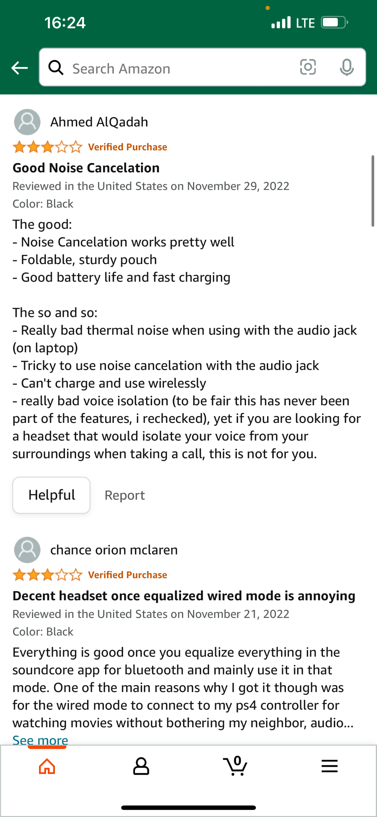
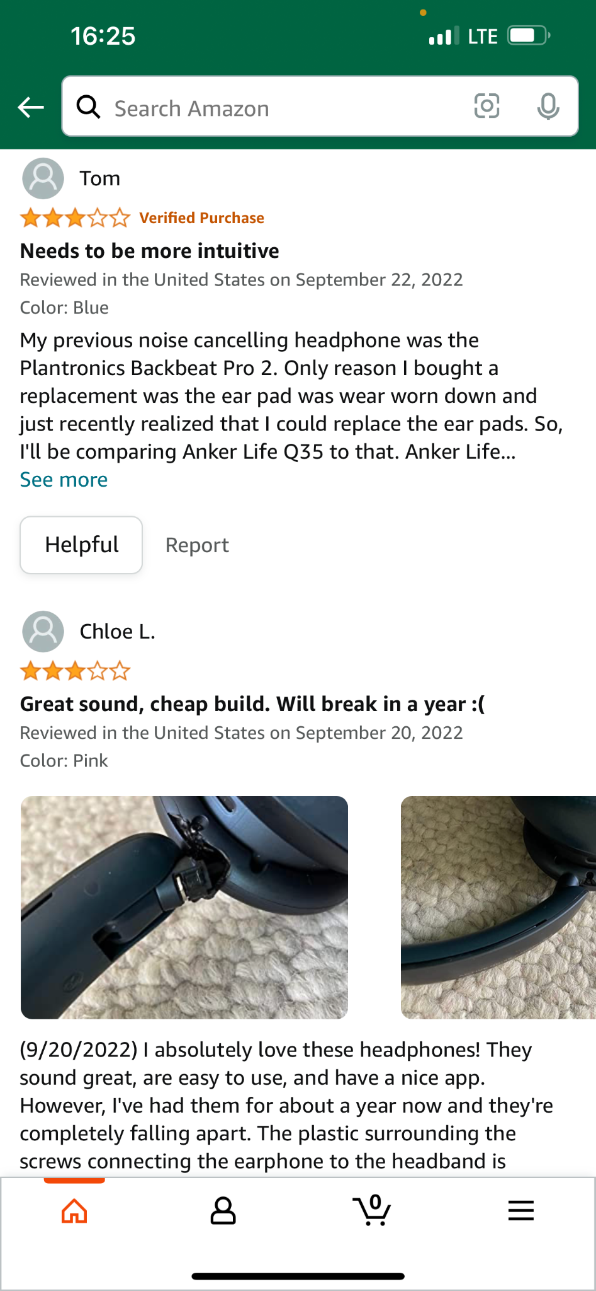
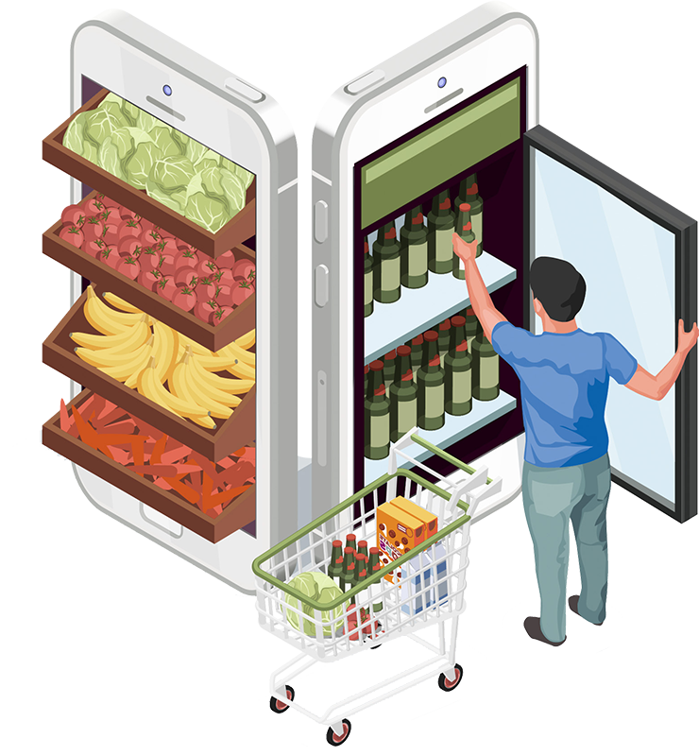
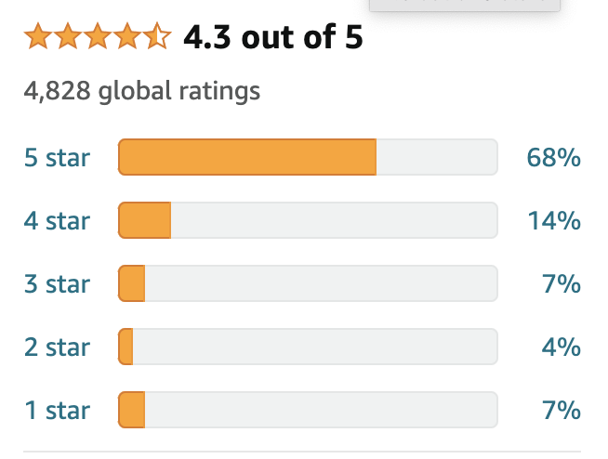
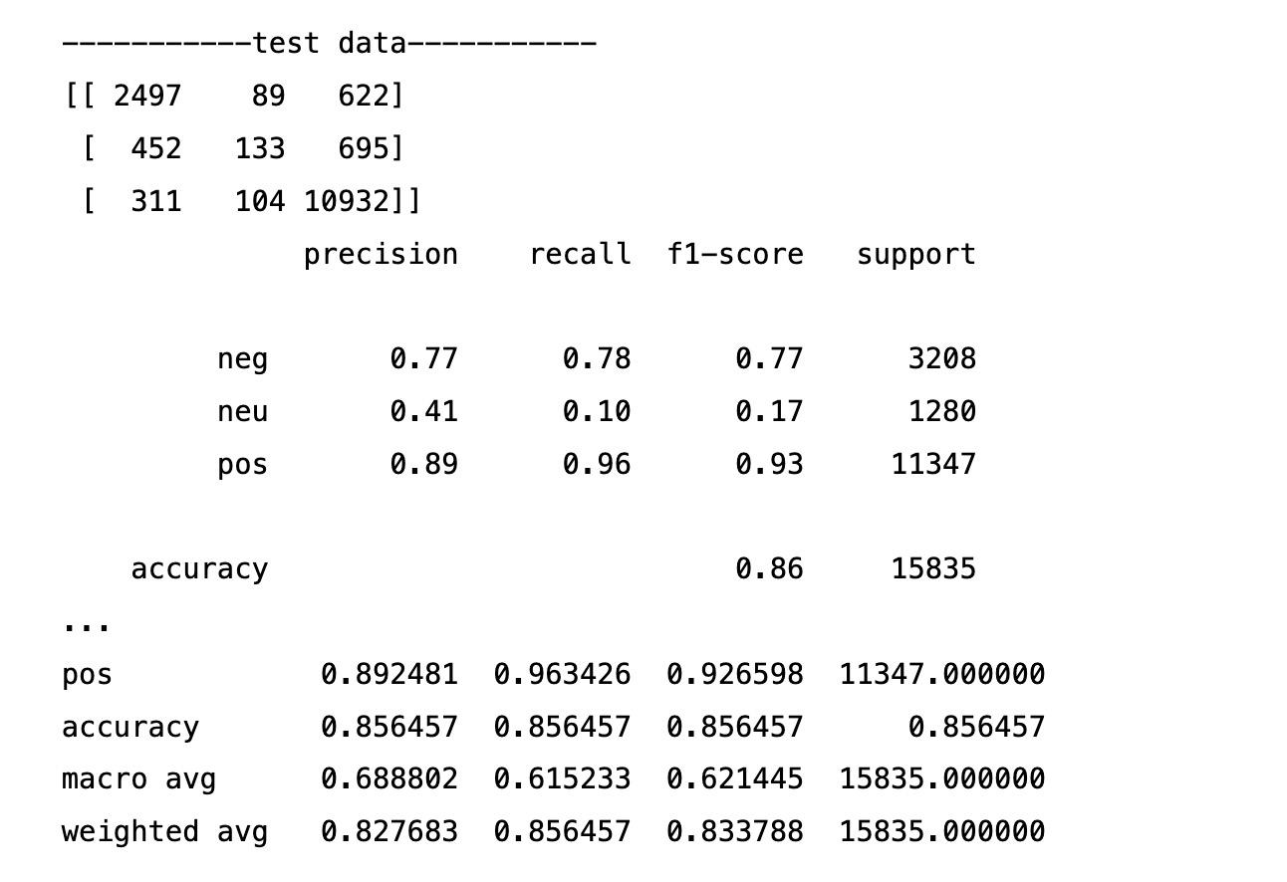
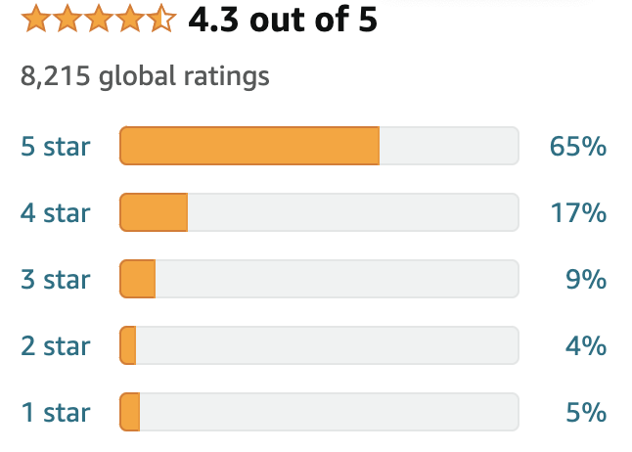
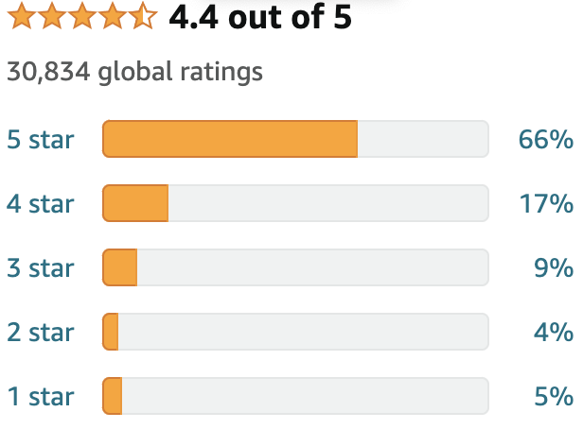
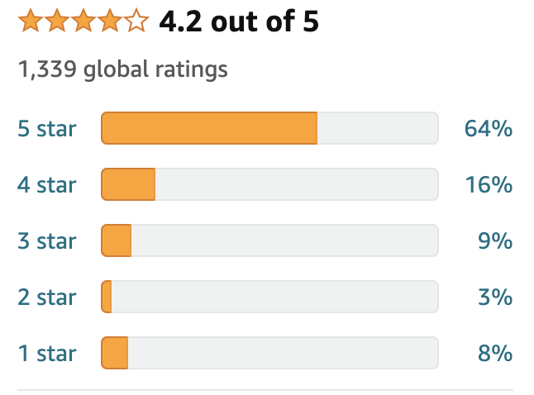
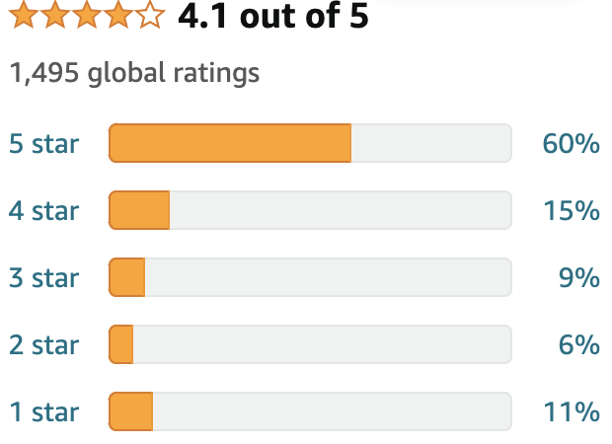
Sentiment Labeling
Notes:
First of all, let's start with a question, that is, how do we do sentiment labeling?
Our initial idea was that according to the rating, there were five rating scores from 1 to 5. We classified 1, 2 as negative, 4, 5 as positive, and 3 as neutral. We tried to run the logit regression model based on this. The result is here. As we can see the f1-score, it is only 0.17 for neural , which is a pretty low score.
So we timely checked the ratings of most headphones and found that most of the average rating scores were above 4. We can see these examples here and we can find that the distributions of 1-5 stars reviews show left skewness. Imagine that when we usually shop at Amazon, when the average rating score of a product is less than 4, we may not choose to buy this product.
However, when the rating score of the product is more than four points, it is very likely that we will not pay such attention to the rating score. For example, when we choose between airpods pro and airpods, their scores are higher than 4. We will not directly choose one to buy only because Amazon's score is 0.1 higher or 0.1 lower, but we would consider it comprehensively. That is to say, when the rating is above four, we are not so sensitive to the rating score.
This is why we choose to classify 4 and 5 as positive. But as for 3, 3-stars reviews often include both good and bad aspects. This is why we chose to classify 3 as neutral at the beginning, but in fact, people often pay more attention to negative information when viewing reviews, so we finally decided to classify 3 as negative. The results obtained in this way are the same as what we expected, with a high accuracy rate.

Slide 25
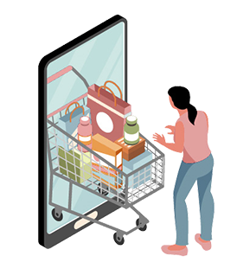
04
Model Evaluation and Model Selection
Notes:
Then it is model evaluation and model selection.

Slide 26
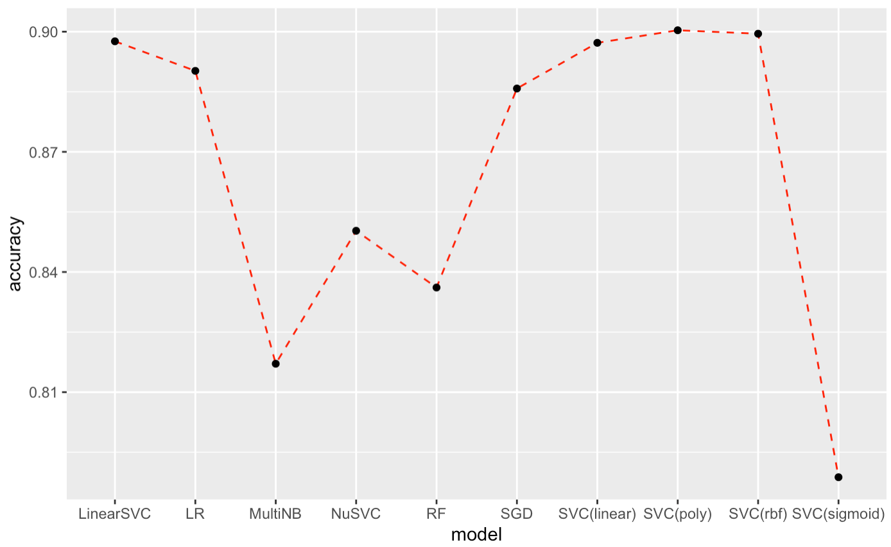
Model evaluation-Machine Learning Models
Accuracy of machine learning models
Based on accuracy, SVC with polynomial kernel performs the best on validation set
Notes:
For Machine learning models, we compare the accuracy of machine learning models, from this graph, we can find that all these ten models perform well with higher than 80% accuracy. And among these models, SVC with polynomial kernel performs the best on validation set.

Slide 27
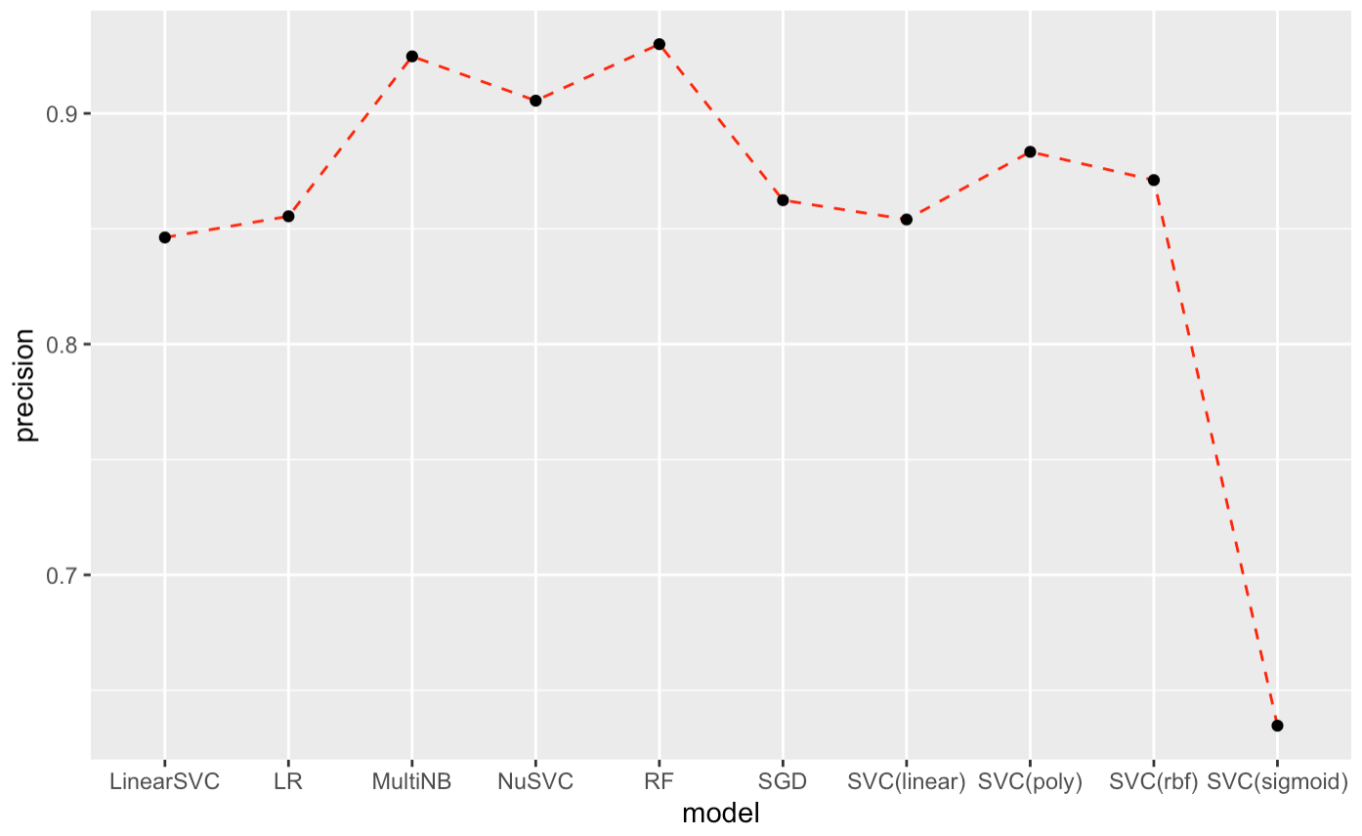
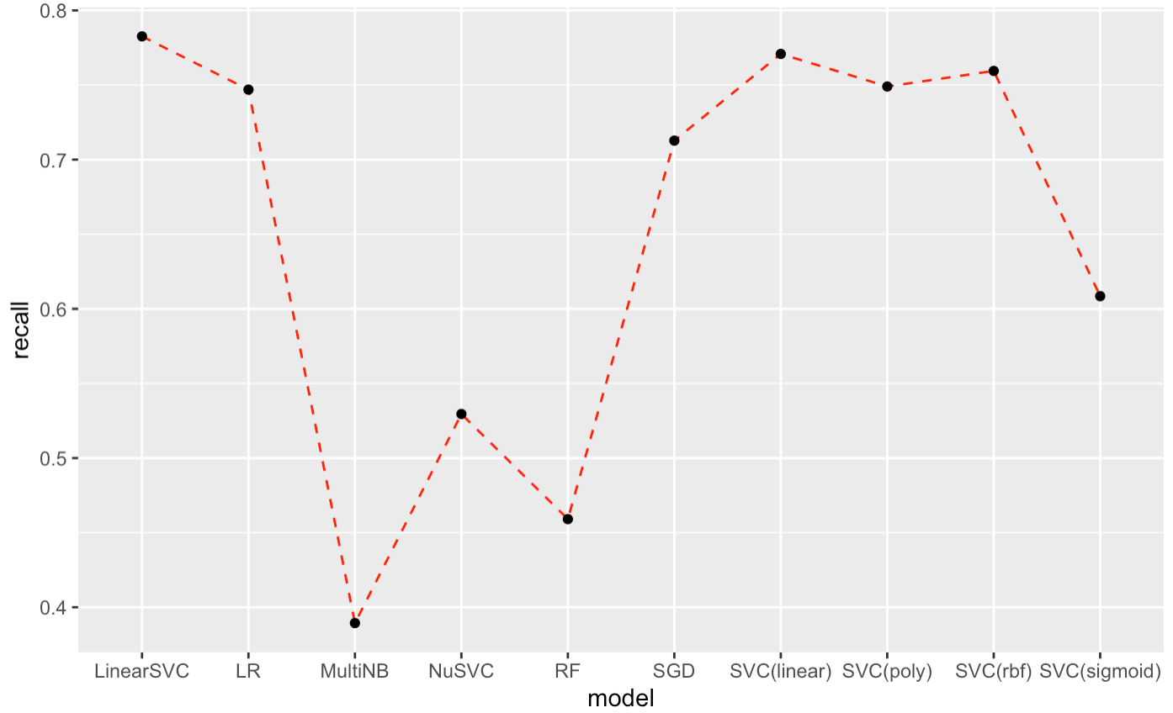
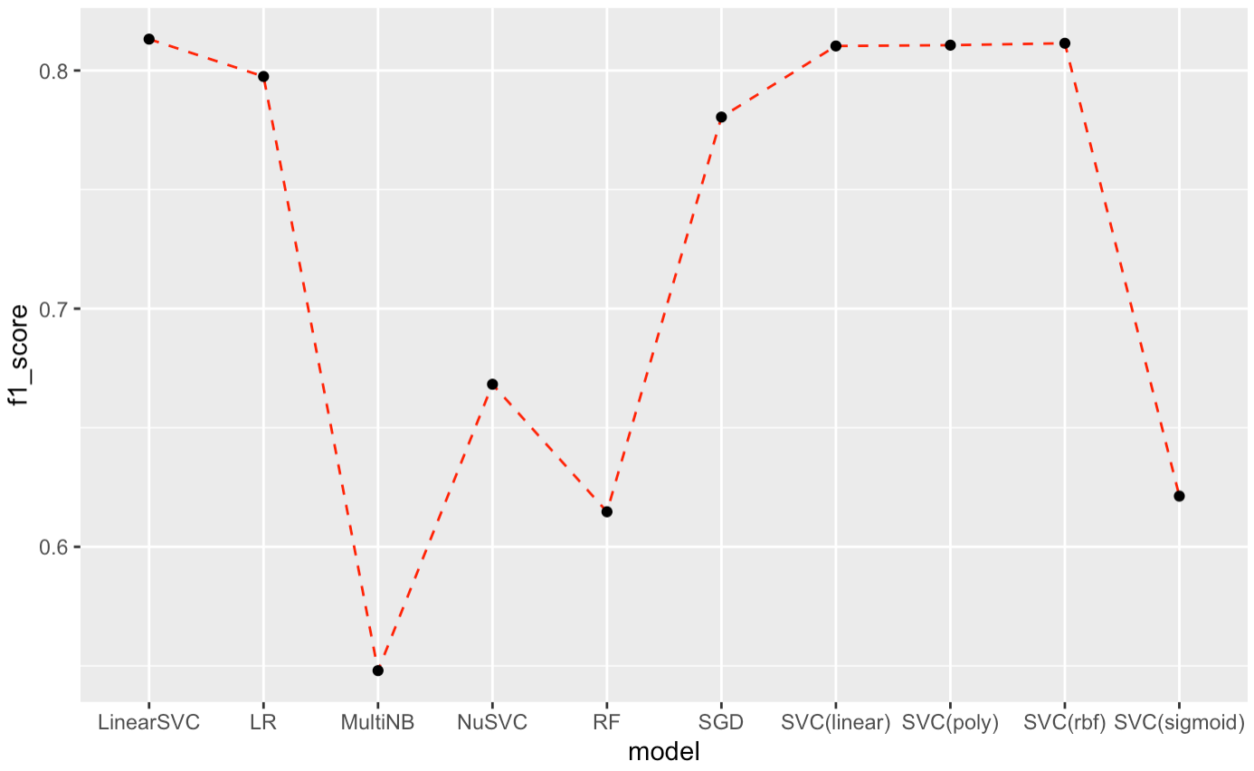
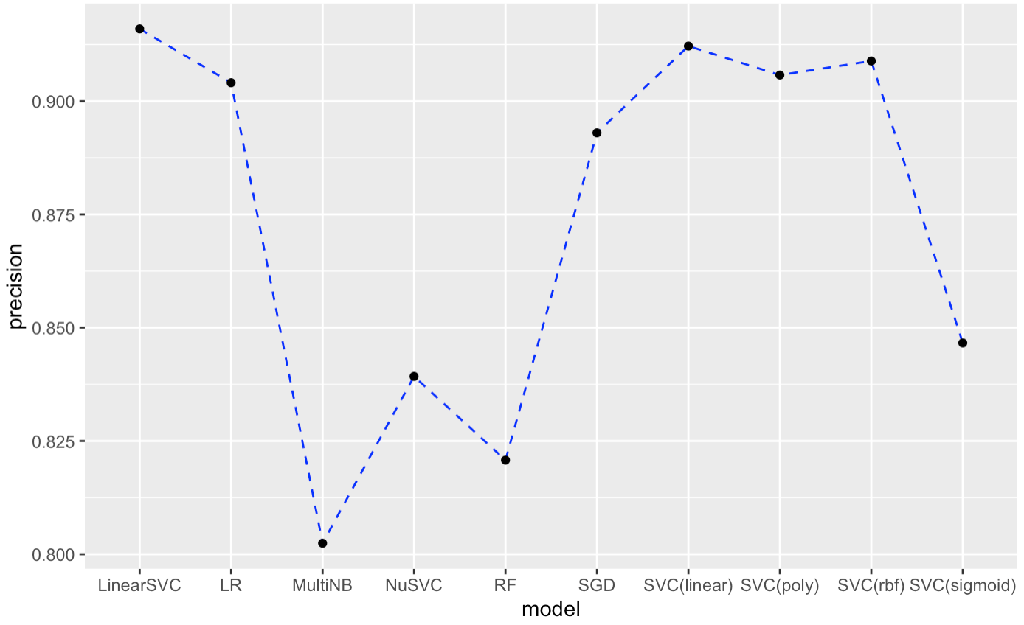
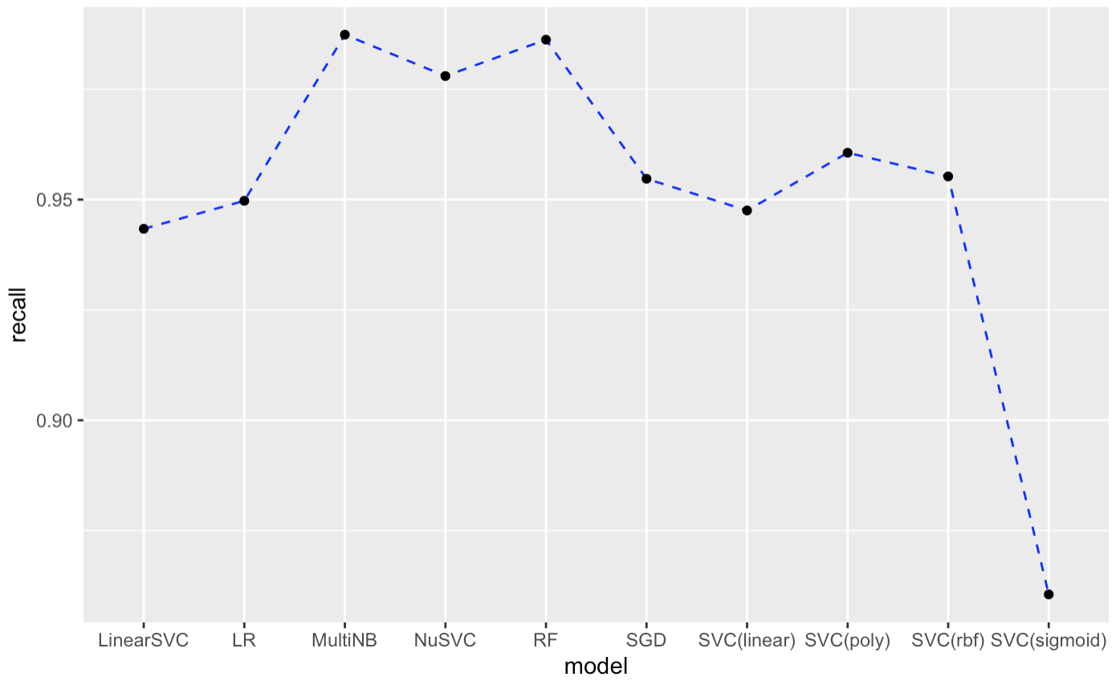
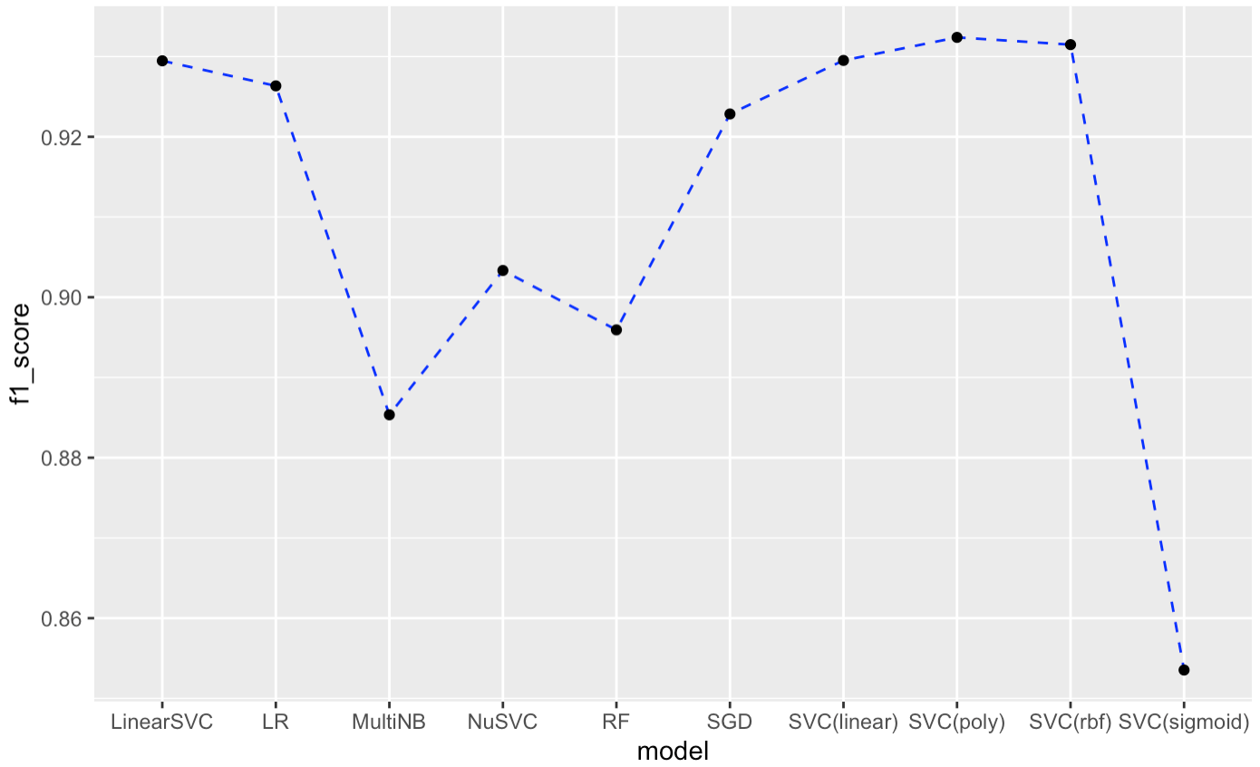
Model evaluation-Machine Learning Models
Precision of machine learning models
Recall of machine learning models
F1-score of machine learning models
Negative
Based on f1-score, SVC with polynomial kernel performs the best on validation set
Positive
Notes:
Here is an extension. We can see that almost all the models perform better in positive than in negative. One of the most likely reasons is the data imbalance between positive and negative set, as we know negative samples are less than positive samples. Here, We compared precision, recall and f1 score. We can also get the same conclusion as the previous slide. As SVC with polynomial kernel performs the best, we know that Nonlinear hyperplane in SVM is more suitable here.

Slide 28
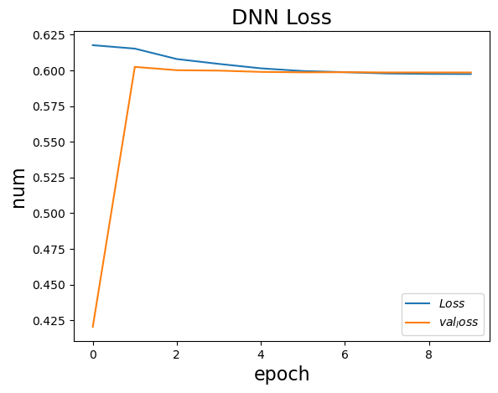
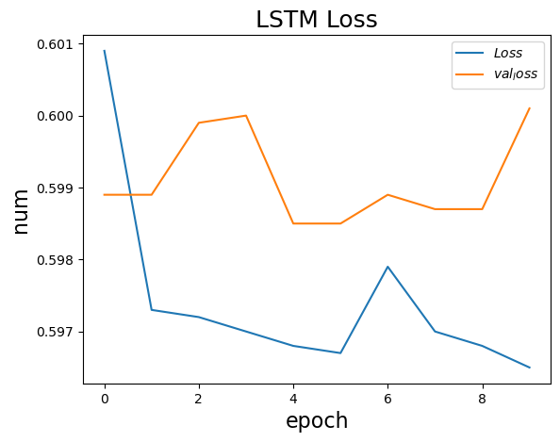
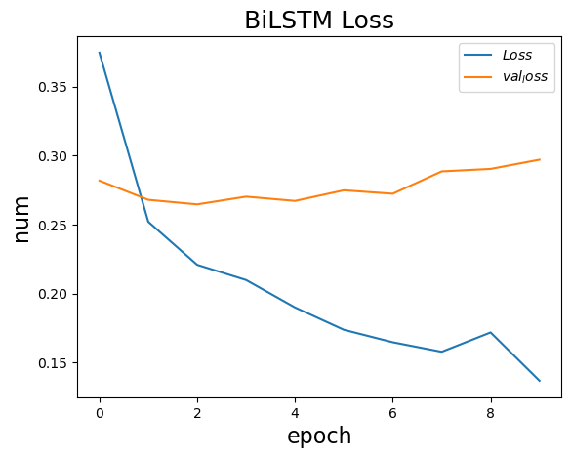
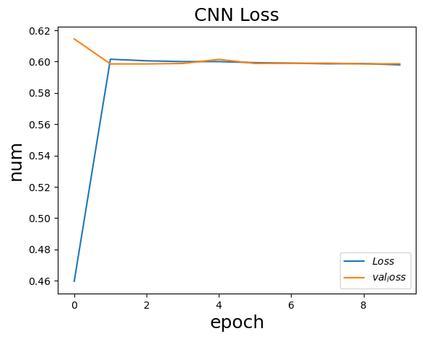
Model evaluation-Deep Learning Models
Based on loss, BiLSTM performs the best on validation set among these four deep learning models
Notes:
And this is the result of deep learning models. we compare loss of these four deep learning models, as we can see BiLSTM performs the best on validation set

Slide 29
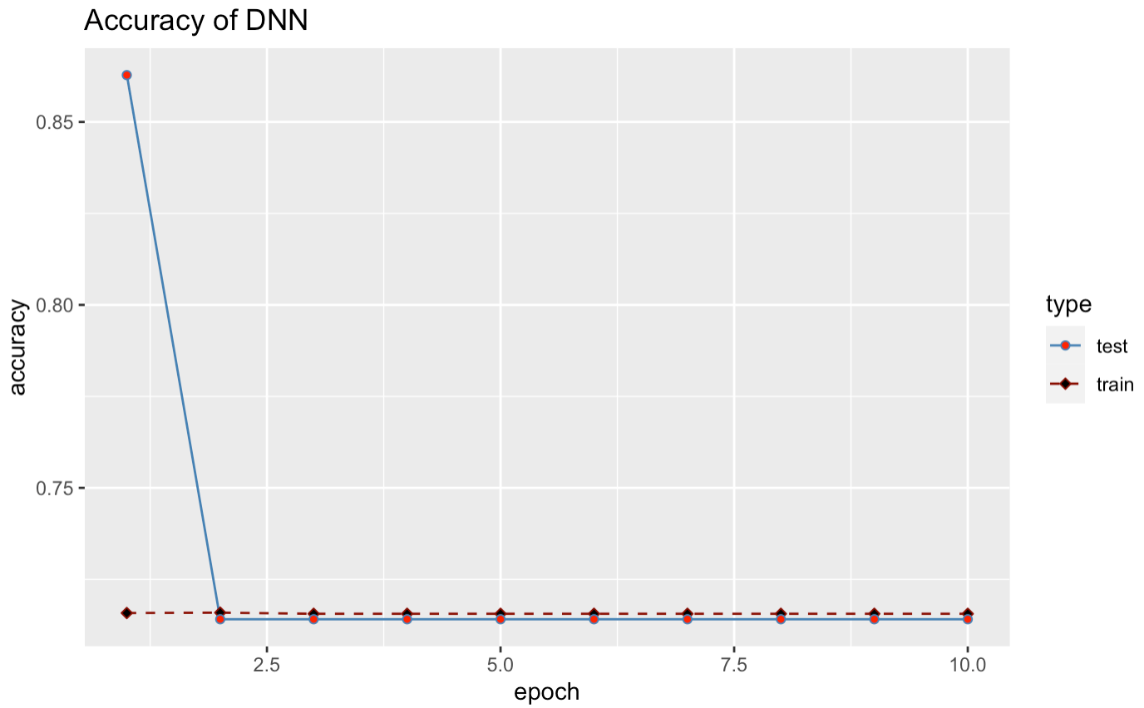
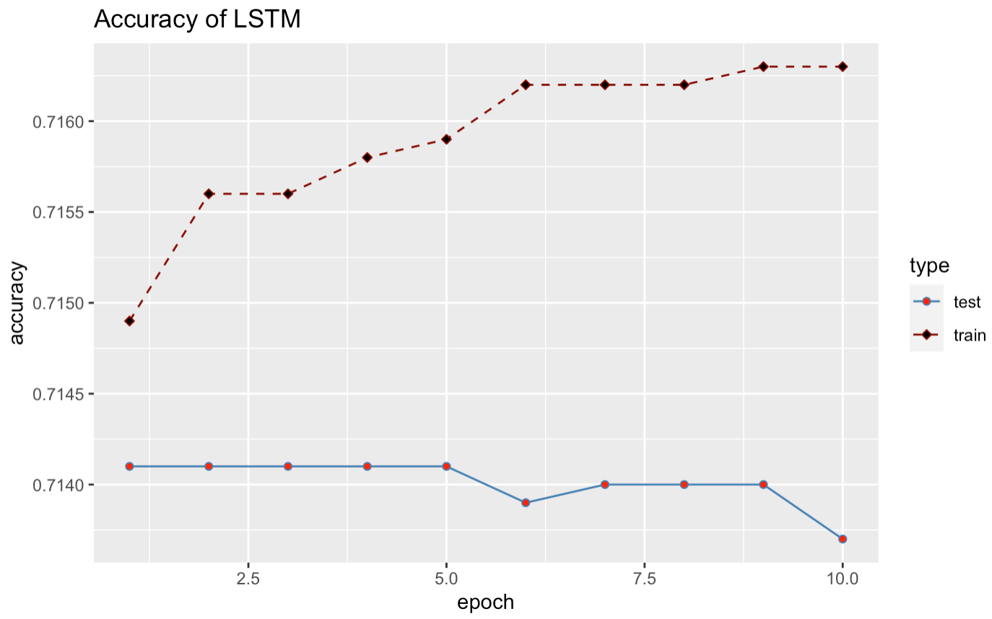
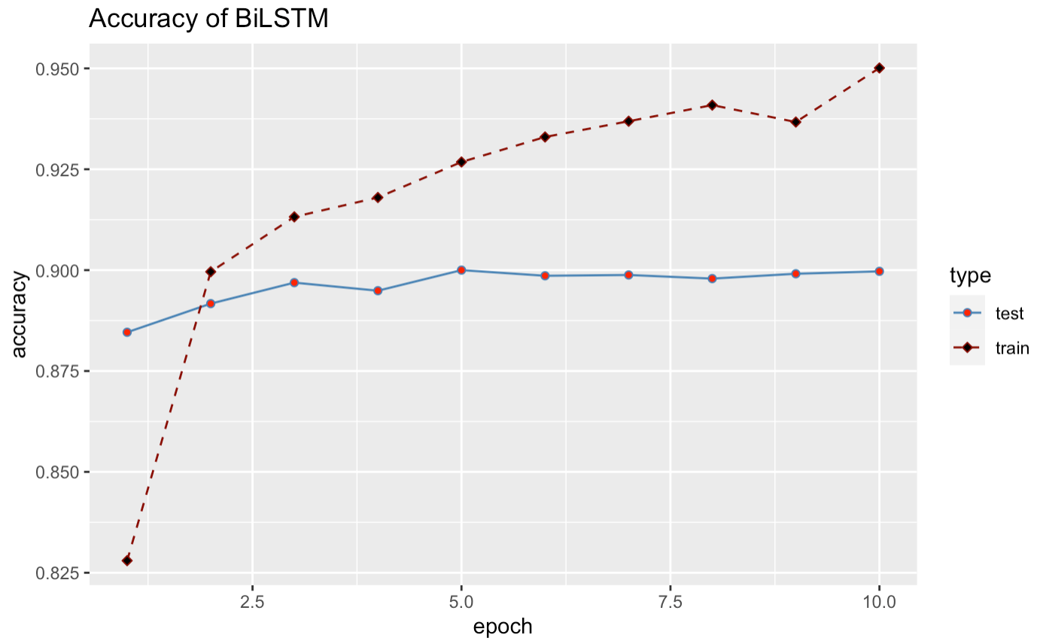
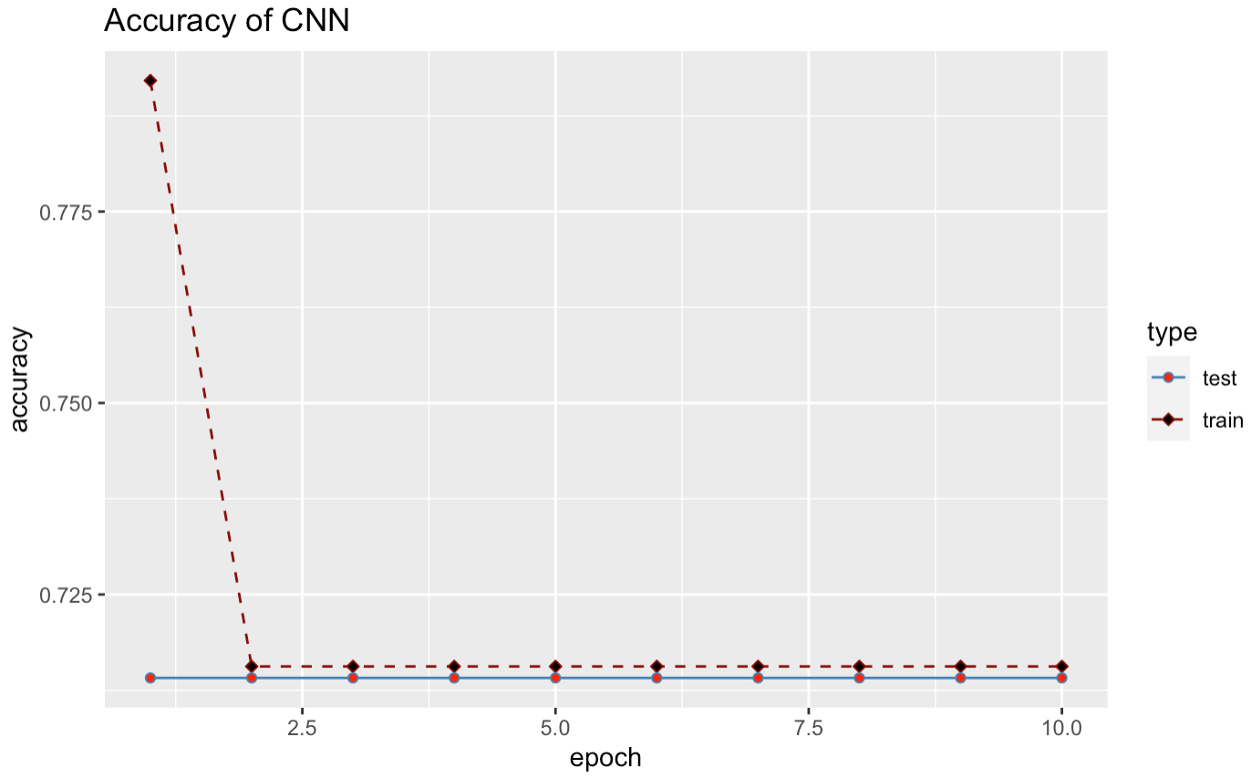
Model evaluation-Deep Learning Models
BiLSTM performs the best on validation set among these four deep learning models with 89.97% accuracy.
However, as SVC with polynomial kernel has higher accuracy, we choose to use SVC with polynomial kernel as our final model
Notes:
Based on accuracy BiLSTM performs the best on validation set too with 89.97% accuracy.
However, as SVC with polynomial kernel has higher accuracy. We choose to use SVC with polynomial kernel as our final model.

Slide 30
Parameter tuning
Accuracy: 90.04%
SVC (polynomial kernel) with C = 1.0 and degree = 2
Accuracy: 90.48%
Notes:
Then the next process is Parameter tuning of our best model. we choose different C, Regularization parameter and different degrees of the polynomial kernel function. And finally, we use parameter combination of C as 1.0 and degree as 2 that we can get better accuracy and f1-score. After parameter tuning, we get the model with 90.48% accuracy in testing set. And this is our final model that will be used in next part.

Slide 31

05
Outcomes
Notes:
So let's see what the final outcome of the whole project is?

Slide 32
Flow Chart of Demo
Input
Data Crawling
Data Pre-processing
Product asin
Crawl 1000 reviews of this product
Perform the same with the process as when training.
Notes:
Of course, we made a demo to help users get real and fair reviews about the product.
In the flow chart of the entire demo, there are five steps in total:
First of all, you can enter the id of an amazon headphone shopping link, which is its asin,
Then our demo will directly crawl out 1000 reviews belonging to the headphone you choose.
And then the demo perform the same preprocessing as when training the model to obtain a clean data set.

Slide 33
Flow Chart of Demo
Predict by model
Output
Predict the sensitive attributes of the reviews
Visualize in table, figure and Word Cloud.
Let’s see the demo!
Notes:
The fourth step is to directly put it into the model with the best effect after evaluation to predict the sensitive attributes(negative or positive) of these reviews.
Finally, it will be displayed to people in a visual way, such as the real positive and negative rates after filtering out fake reviews.
Next, I will show you the specific parts of our demo and the output effect.

Slide 34
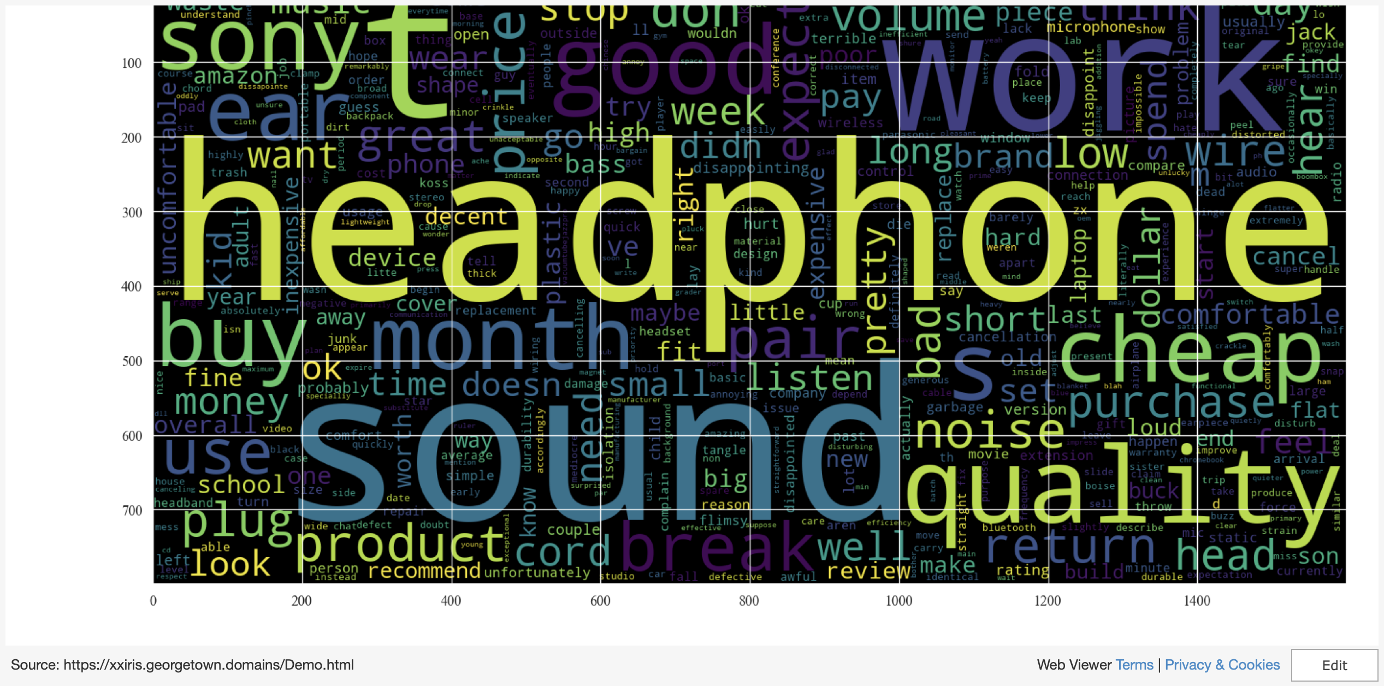
Demo
Notes:
As you can see in the demo, people can input the asin, and through the data gathering, data preprocessing, at the end of data preprocessing, We reload the count vectorizer and tfidf vectorizer obtained during training. At the same, we reload the selected model and just need to use the cleaned data to predict the result.
finally, the demo print the Product Rating table, figure and the negative review word clouds.
At the output of demo, we chose to encapsulate the code for the process.

Slide 35
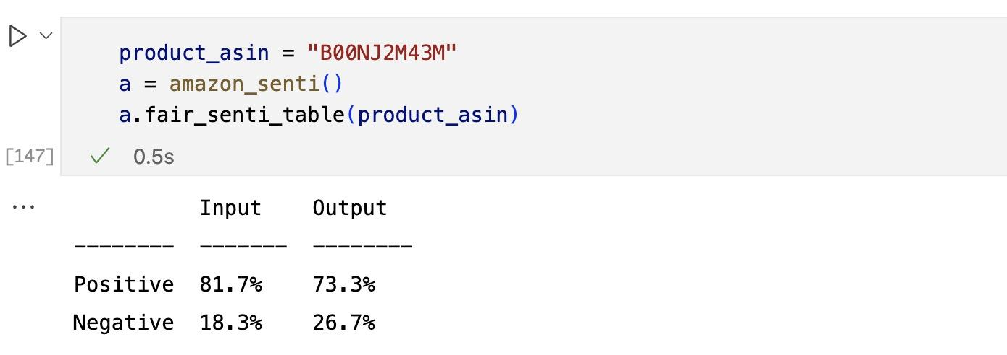
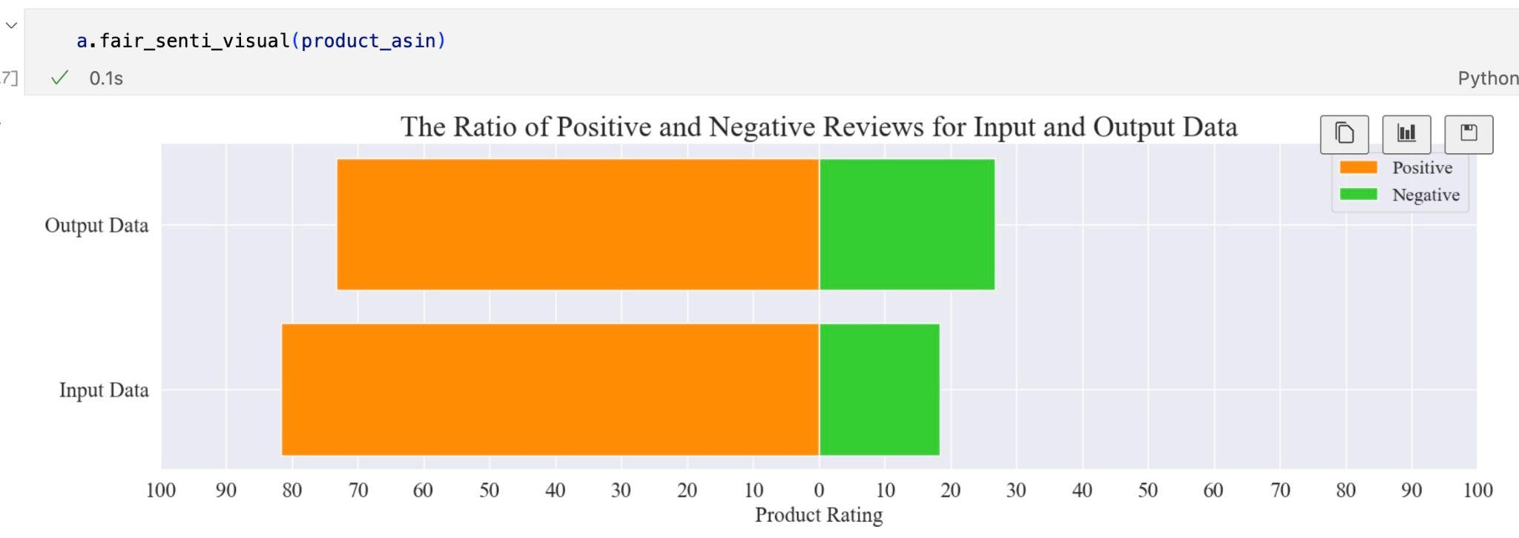
Demo Output
Notes:
Going back to the original assumption, I want to pick a headphone from my previous selections, and their prices are similar, and they have the same rating. So how do I find the right headphone for me?
Now it's time to analyze by using this demo. I input the asin of a headphone, and after a short wait, I can see the output of the demo directly, and found that there is a big difference between the real comment and the original comment.

Slide 36
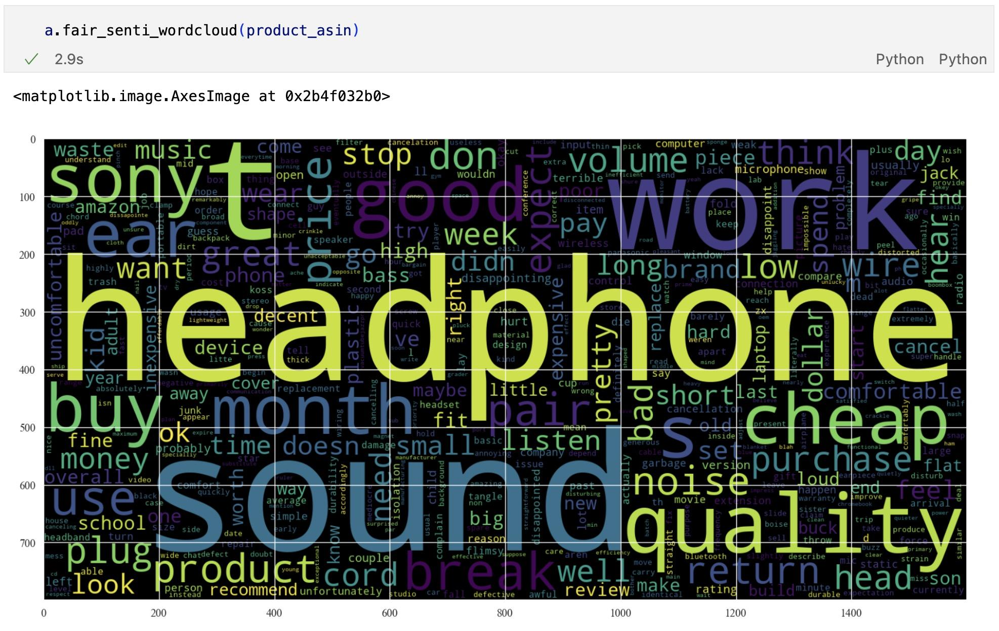
Demo Output
Notes:
And through the negative word cloud map, I found that there are some key words like ”short” maybe it means the battery life of headphone is short; like “cheap”, maybe they think the headphone is cheap and not good. So I need to consider whether there is still an idea to buy this headphone.

Slide 37
06
Conclusion
Notes:
So let me conclude by saying the summarize, compared with proposal and future prospect.

Slide 38
Summarize
Review Crawling
Data Pre-Processing
Model Selecting
Demo
Notes:
In summary, throughout the project, we crawled reviews of 150 products in the Amazon headphone category.
We performed regular data cleaning on the data. Also according to the actual requirement of / reducing the impact of fake reviews on users' real judgments, we have carried out more preprocessing.
Next, we use the cleaned data to test the effect of machine learning and deep learning methods, then select the SVM model with the best effect, and then adjust the parameters of the model for optimization. This filters out the best models.
In the fourth step, we made a demo. In this demo, input the asin of the headphone to directly get the real positive rate and negative rate of the product after removing the fake review, and display the negative rate through the word cloud.

Slide 39
Conclusion
Compared with the proposal
Summarize
Future Prospect
1.Review Crawling
2.Data cleaning
3.match the best model
4.Demo
1.Complete all the ideas mentioned.
2. Optimize the presentation form of the Output.
Can be applied to all Amazon products!!!
Notes:
Our project is done here and compared with the original proposal, we can find that we have completed all the ideas mentioned.
In addition, the presentation form of the output is optimized, which also brings users a more intuitive experience and a more convenient operation experience.
In this project, we chose the category of earphones to show the results through specific categories, and the related terms of earphones are explanatory when analyzing the results (such as good noise reduction effect and poor sound effect), not just Simply say "good".
You can also see that we use the asin of products when crawling reviews, which means that our project is not limited to the category of headphones, but can be applied to all Amazon products, as long as the user provides asin , through our implementation, we can directly output the real positive and negative ratings.
However, here are some limitations. The first situation is that we cannot completely avoid merchants manually reviewing positive and negative reviews, because generally positive reviews and negative reviews are machine reviews, which can have a certain similarity in text information. However, if the merchant asks users who have purchased this product to give a good review, we cannot predict this situation.
Second, Our training model is based on headphone category data, so when this model is applied to all categories, the accuracy may not be high

Slide 40
Limitation
The first situation is that we cannot completely avoid merchants manually reviewing positive and negative reviews, because generally positive reviews and negative reviews are machine reviews, which can have a certain similarity in text information. However, if the merchant asks users who have purchased this product to give a good review, we cannot predict this situation.
Secondly, we only did parameter tuning for the model with the best performance in validation, but not for other models. After adjusting the parameters, other models may have better performance.
Notes:
However, here are some limitations。
The first situation is that we cannot completely avoid merchants manually reviewing positive and negative reviews, because generally positive reviews and negative reviews are machine reviews, which can have a certain similarity in text information. However, if the merchant asks users who have purchased this product to give a good review, we cannot predict this situation.
Secondly, we only did parameter tuning for the model with the best performance in validation, but not for other models. After adjusting the parameters, other models may have better performance.

Slide 41
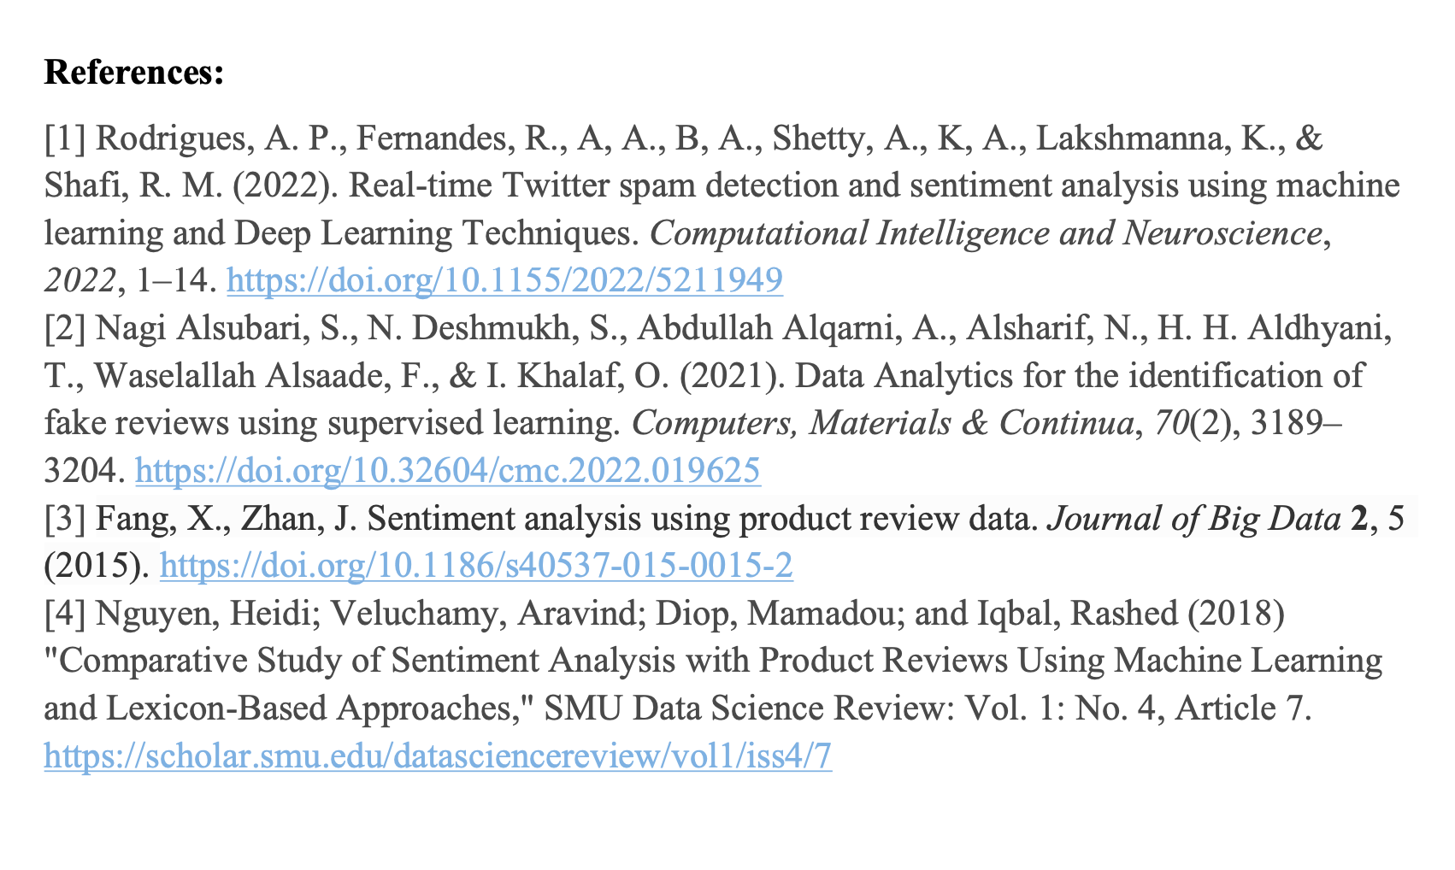


Notes:
So this is the end of our presentation, thank you for your listening. Any question?

Slide 42
THANKS
Do you have any questions?
Notes:
So this is the end of our presentation, thank you for your listening. Any question?

